Slide 1


Legal Document Summarization
Name:- Ahmed Saad
Id:- 194449
Supervised by:- Dr. wael Hassan

Slide 2

Agenda
Introduction
Problem Definition
Objective
Related work 1
Related work 2
Methods of approach
Demo

Slide 3
INTRODUCTION

Slide 4
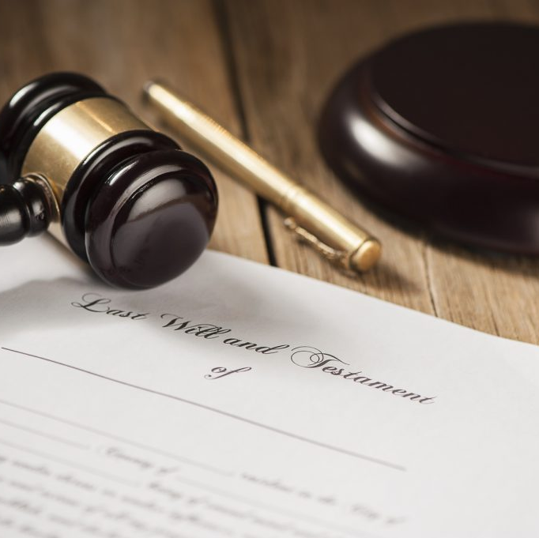
INTRODUCTION
The "Legal Document Summarization" project aims to address the pressing need for an efficient and accurate solution to the overwhelming volume of legal documents, such as contracts, court cases, statutes, and legal opinions.
The legal field is inundated with extensive, complex, and highly technical textual information, making it challenging for legal professionals to extract critical insights, relevant information, and key points from these documents in a time-effective manner.

Slide 5
Problem Definition

Slide 6
Problems Faced to be solved:
Time-Consuming: Reading and comprehending extensive legal documents can be time-consuming and labor-intensive, affecting the efficiency of legal work.
Information Overload: Legal professionals are often overwhelmed by the sheer volume of documents they must review, making it difficult to locate the most critical information.
Risk of Missing Key Information: Failing to identify and extract important details, clauses, or precedents can result in costly errors or adverse legal outcomes.
Language Complexity: Legal texts are typically written in complex, specialized language that may not be easily understood by those without legal training.
Regulatory Compliance: Ensuring compliance with laws and regulations requires a deep understanding of legal documents, which can be a daunting task.

Slide 7
Related work 1
The Goal of this study is to improve the way Legal Documents , Terms and Conditions contracts are presented and analyzed.
Data Set : The Dataset used for determining the category of the document was obtained by crawling through the documents available in Indian Kanoon which is a website contains a lot of courts legal documents around India.
This study used:-
Naïve Bayes Model for prediction of the category.
TF-IDF for scoring sentences.
ROUGE package for evaluation(Accuracy 94.2%).

Slide 8
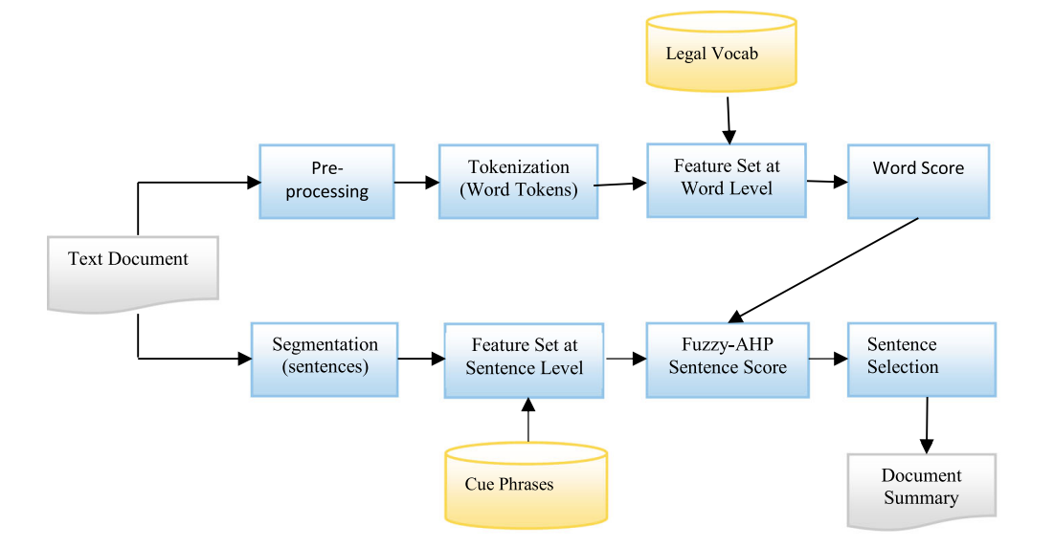
Related work 2
Data Set used in this paper was collected from Indian IT ACT
Dividing the text document on basis of sentence(Segmentation)
Feature weighting using fuzzy AHP
Used ROUGE tool for evaluation.(Accuracy 80%)

Slide 9
Data Set
This dataset contains legal cases downloaded from huggingFace.
- Dictionary type data set of 3 files:-
1- Train.
2- validation.
3- Test
Note:- All 3 files contains the same attributes(id,sources,sources_metadata,summary/long, summary/short, summary/tiny, case_metadata)
- Files type of the data set is json files.

Slide 10
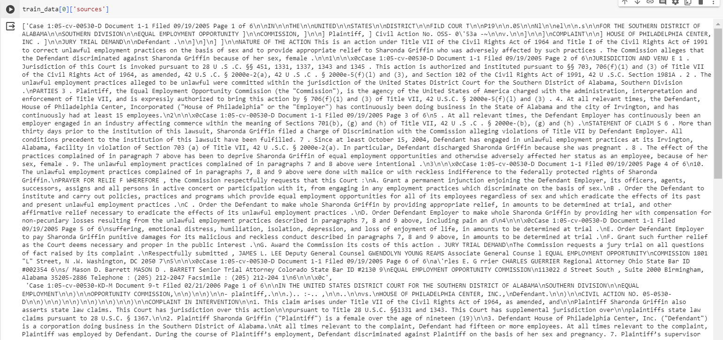
Data Set : Full Text

Slide 11
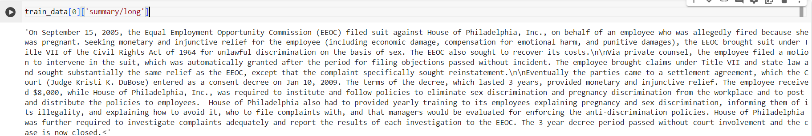
Data Set : Summary/Long

Slide 12
OBJECTIVE
The objective of the "Legal Document Summarization" project is to develop a robust, automated system that can read, summarize, and condense legal documents into concise and coherent summaries. This system should address the following specific goals:
Content Extraction: Identify and extract critical information, including key legal principles, clauses, precedents, and relevant case law from legal documents.
Language Simplification: Convert complex legal language into plain and understandable text to facilitate broader comprehension.
Time Efficiency: Significantly reduce the time and effort required for legal professionals to review and extract important information from legal documents.
Error Reduction: Minimize the risk of missing essential details, which can lead to costly legal mistakes or oversights.

Slide 13
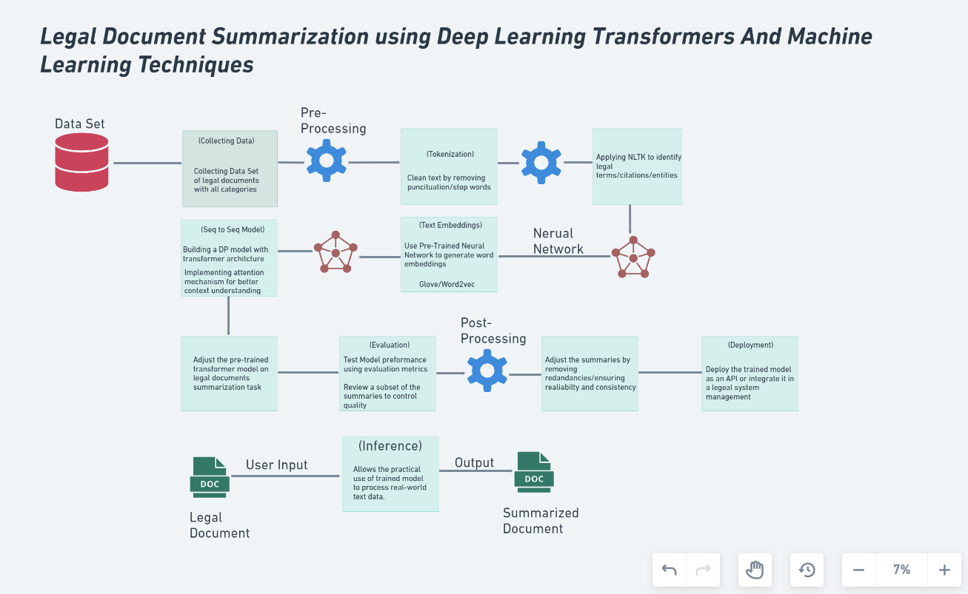
Proposed System Architecture 1
Methods of Approach:
NLTK
Transformer Architecture (Seq to Seq)
Bert For Coisne Similarity Score

Slide 14
Challenges
Legal Terminology And Jargon: Legal documents contain complex legal terminology and jargon, often challenging for non-legal experts to understand. Creating a system to accurately translate this specialized language into plain terms is a formidable task.
Document Diversity: Various types of legal documents including contracts , court cases and legal opinions.
Complex Sentence Structure: Legal documents often feature convoluted sentence structures, with nested clauses and conditional statements. The summarization system must be able to untangle these complexities to provide clear and concise summaries.
Bias and Fairness: Legal document summarization systems must be designed to avoid bias and unfairness, which could lead to inaccurate or skewed summaries

Slide 15
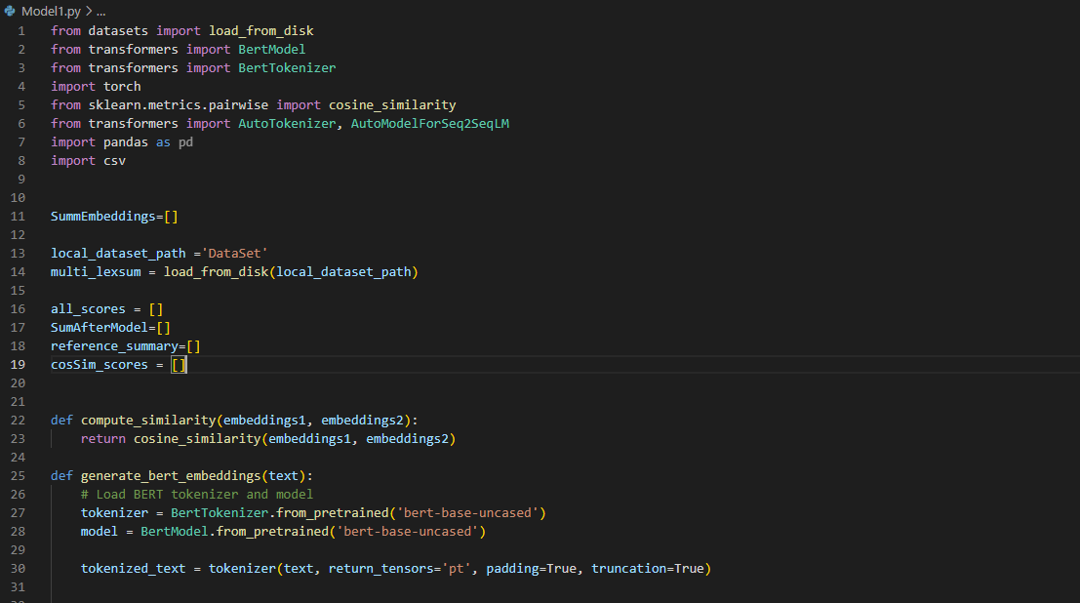
Demo

Slide 16
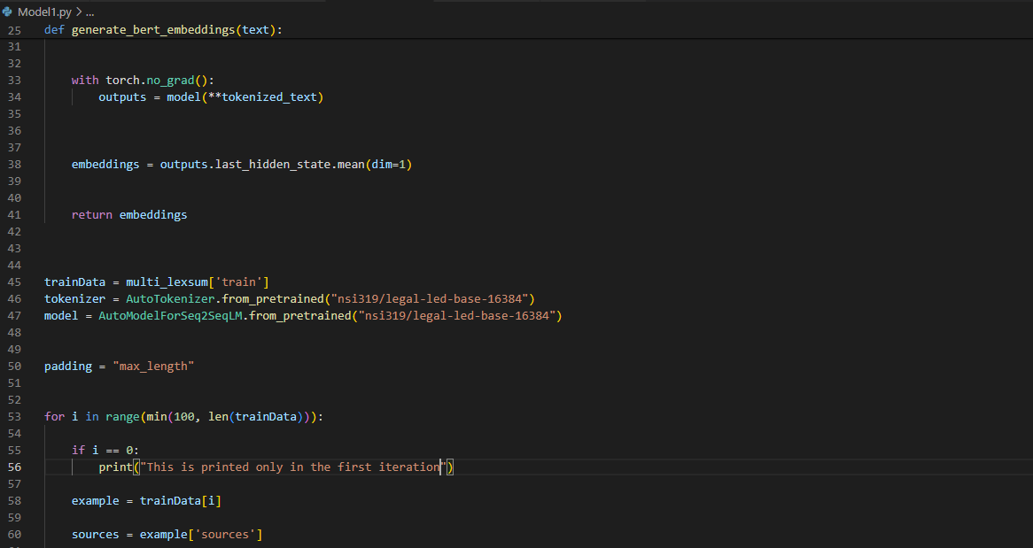
Demo

Slide 17
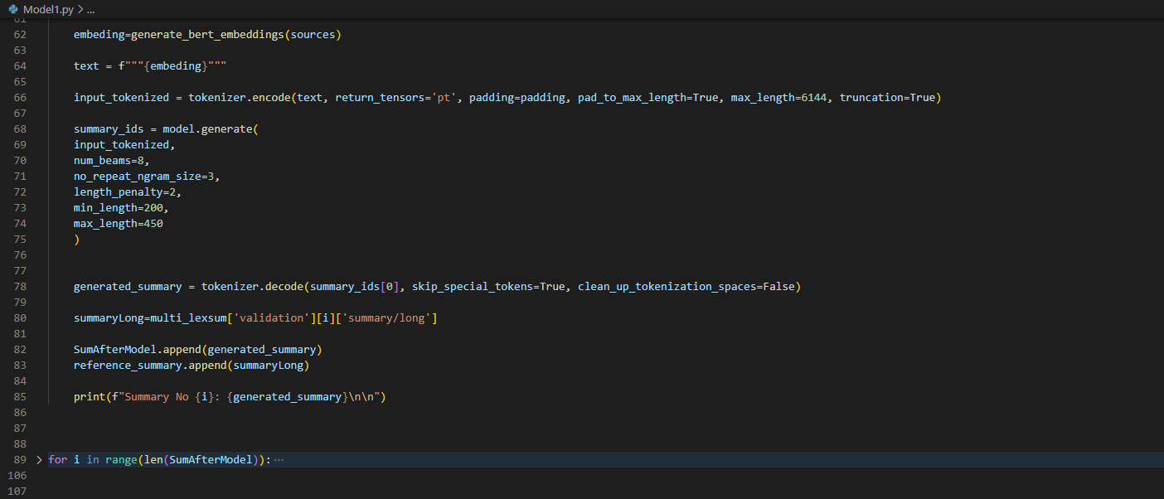
Demo

Slide 18
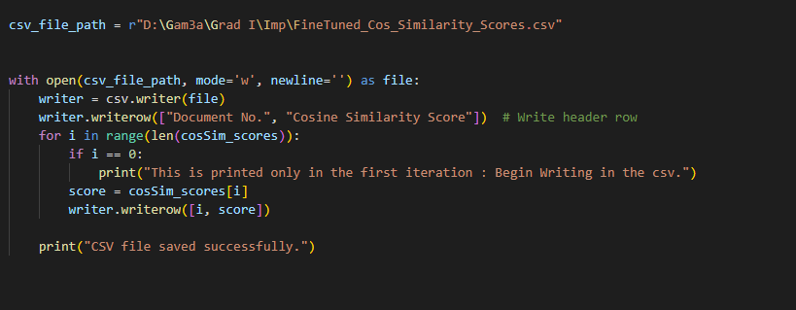
Demo

Slide 19
Demo Results

Slide 20
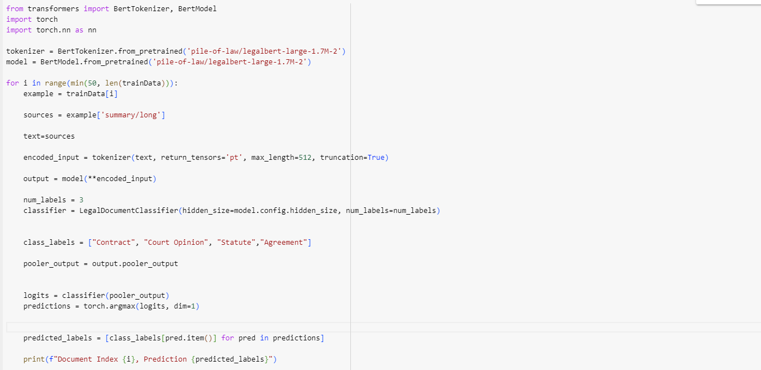
Classification Using Legal BERT

Slide 21
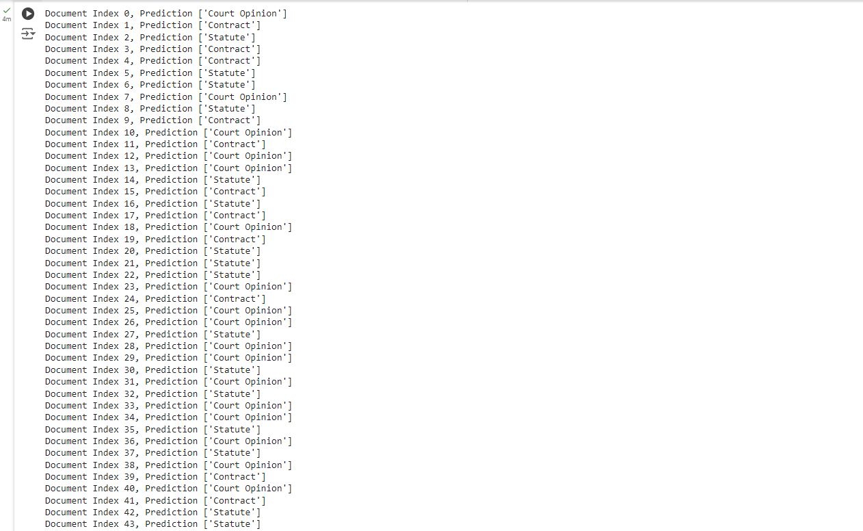
Classification Results Before Fine Tuning

Slide 22
To Do:
Fine Tunes the Classification model to fit the needs of the data set.
Consider new model to be compared to already used one and choose the best between them after evaluation both using cosine similarity.

Slide 23
Target Audience
The project will benefit a broad spectrum of legal professionals, including lawyers, paralegals, judges, legal researchers, and anyone dealing with legal documents. It will empower them to work more efficiently, make informed decisions, and reduce the risks associated with legal document review.

Slide 24
Conclusion
In summary, the use of advanced legal document analysis and summarization systems is revolutionizing and can give outstanding results with huge legal document using Machine and Deep Learning in comparison with human summaries.

Slide 25
References
Garcia, L., Smith, P. J., & Johnson, R. K. (2019). Automated Summarization of Legal Texts. In Proceedings of the International Conference on Natural Language Processing and Legal Technology (pp. 112-126). Springer.
Zhang, H., Liu, Y., & Wang, L. (2016). Natural Language Processing for Legal Text Analysis. Proceedings of the 11th International Conference on Artificial Intelligence and Law, 56-70.
Roberts, A. (2020, July 20). Advanced Techniques in Legal Document Summarization. Legal Insights. https://www.example.com/legal-insights/adv-legal-doc-summarization
Li, X., Zhang, Q., & Liu, H. (2019). Leveraging Neural Networks for Legal Text Summarization. Proceedings of the ACM International Conference on Information and Knowledge Management, 237-245.
Nguyen, T., & Bowman, S. (2018). Machine Learning Techniques for Legal Document Analysis. In P. Garcia (Ed.), Machine Learning Applications in Legal Contexts (pp. 101-120). Springer.

